Slide 1
Unit IV

Slide 2
COURSE LEARNING RATIONALE (CLR) | The purpose of learning this course is to:
CLR-1: | Think and evolve with a logic to construct an algorithm and pseudocode that can be converted into a program
CLR-2 : | Utilize the appropriate operators and control statements to solve engineering problems
CLR-3 : | Store and retrieve data in a single and multidimensional array
CLR-4 : | Create custom designed functions to perform repetitive tasks in any application
CLR-5 : | Create basic Abstract Data Types with python
CLR-6 : | Create applications using suitable python library functions for solving datascience problems

Slide 3
Course Learning Outcomes (CLO) | At the end of this course, learners will be able
CLO-1: | To solve problems through computer programming. Express the basic data types and variables in C
CLO-2: | To use appropriate data types in simple data processing applications. To create programs using the concept of arrays
CLO-3: | To create string processing applications with single and multi-dimensional arrays
CLO-4: | To create user defined functions with required operations. To implement pointers in applications with dynamic memory requirements.
CLO-5: | To create programs using the python data types, loops, control statements for problem solving
CLO-6: | To implement the suitable python library based solutions for solving statistical problems in data science

Slide 4
Python
Python is a high-level, interpreted, interactive and object oriented-scripting language, designed to be highly readable, commonly uses English keywords.
Python is Interpreted: This means that it is processed at runtime by the interpreter and you do not need to compile your program before executing it. This is similar to PERL and PHP.
Python is Interactive: This means that you can actually sit at a Python prompt and interact it directly to write your programs.
Python is Object-Oriented: This means that Python supports Object-Oriented style or technique of programming that encapsulates code within objects.
Python is Beginner's Language: Python is a great language for the beginner programmers and supports the development of a wide range of applications

Slide 5
FEATURES OF PYTHON
Python is object-oriented
Structure supports such concepts as polymorphism, operation overloading, and multiple inheritance
It's free (open source)
Downloading and installing Python is free and easy
Source code is easily accessible
Free doesn't mean unsupported! Online Python community is huge
It's portable
Python runs virtually every major platform used today
As long as you have a compatible Python interpreter installed, Python programs will run in exactly the same manner, irrespective of platform

Slide 6
It's powerful
Dynamic typing
Built-in types and tools
Library utilities
Third party utilities (e.g. Numeric, NumPy, SciPy)
Automatic memory management
It's mixable
Python can be linked to components written in other languages easily
Linking to fast, compiled code is useful to computationally intensive problems
Python is good for code steering and for merging multiple programs in otherwise conflicting languages

Slide 7
It's easy to use
Rapid turnaround: no intermediate compile and link steps as in C or C++
Python programs are compiled automatically to an intermediate form called bytecode, which the interpreter then reads
This gives Python the development speed of an interpreter without the performance loss inherent in purely interpreted languages
It's easy to learn
Structure and syntax are pretty intuitive and easy to grasp
Scalable:
Python provides a better structure and support for large programs than shell scripting.

Slide 8
Data types
The data stored in memory can be of many types. For example, a persons age is stored as a numeric value and the address is stored as alphanumeric characters.
Python has some standard types that are used to define the operations possible on them and the storage method for each of them.
Python has five standard data types:
Number
String (Immutable)
List (entries enclosed in [ ], list methods available)(Mutable)
Tuple(comma separated values of possible different types)(Immutable).
Dictionary (un-ordered, key:value sequences in [ ]

Slide 9
Floating points
The float type in Python represents the floating point number. Float is used to represent real numbers and is written with a decimal point dividing the integer and fractional parts.
Example:
97.98, 32.3+e18, -32.54e100 all are floating point numbers.

Slide 10
BOOLEAN EXPRESSIONS
A boolean expression is an expression where the result is either true or false.
The result of any relational operator will be a Boolean value
Example
>>> 5 == 5
True
>>> 5 == 6
False

Slide 11
INTEGER:
This value is represented by int class. It contains positive or negative whole numbers (without fraction or decimal). In Python there is no limit to how long an integer value can be.
EXAMPLE:
0, 1057, -2347

Slide 12
String
Strings in Python are identified as a contiguous set of characters in between quotation marks.
Python allows for either pairs of single or double quotes. Subsets of strings can be taken using the slice operator ( [ ] and [ : ] ) with indexes starting at 0 in the beginning of the string and working their way from -1 at the end.
The plus ( + ) sign is the string concatenation operator, and the asterisk ( * ) is the repetition operator.

Slide 13
Example:
>>> str = 'Hello World!’
>>> print (str) # Prints complete string
>>> print (str[0]) # Prints first character of the string
>>> print (str[2:5] ) # Prints characters starting from 3rd to 6th
>>> print (str[2:5:2] ) # Prints characters starting from 3rd to 6th skip by 2
>>> print (str[2:] ) # Prints string starting from 3rd character
>>> print (str * 2) # Prints string two times
>>> print (str + "TEST“) # Prints concatenated string
The above code will produce following output:
Hello World!
H
llo
lo
llo World!
Hello World!Hello World!
Hello World!TEST

Slide 14
Built in string method
Python includes following built in string method:
Example:
>>>'The happy cat ran home.'.upper()
'THE HAPPY CAT RAN HOME.’
>>> 'The happy cat ran home.'.find('cat')
10
>>> 'The happy cat ran home.'.find('kitten')
-1
>>> 'The happy cat ran home.'.replace('cat', 'dog')
'The happy dog ran home.'

Slide 15
s.lower(), s.upper() -- returns the lowercase or uppercase version of the string
s.strip() -- returns a string with whitespace removed from the start and end
s.isalpha()/s.isdigit()/s.isspace()... -- tests if all the string chars are in the various character classes
s.startswith('other'), s.endswith('other') -- tests if the string starts or ends with the given other string
s.find('other') -- searches for the given other string (not a regular expression) within s, and returns the first index where it begins or -1 if not found
s.replace('old', 'new') -- returns a string where all occurrences of 'old' have been replaced by 'new‘

Slide 16
String creation
a = “bala”
print(a)
O/p:-
‘bala’

Slide 17
Length of string
a = “bala”
print(len(a))
O/p:-
4

Slide 18
Error handling
Wherever Python detects an error it raises exceptions
Default behavior: stops program.
Otherwise, code try to catch and recover from the exception (try handler)

Slide 19
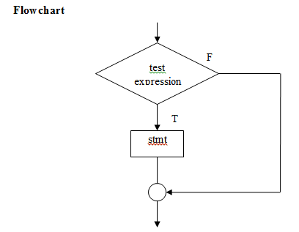
CONDITIONAL if
Syntax:
if boolean_expression:
true statement

Slide 20
Example:
x=5
if x > 0:
print 'x is positive'
Output:
x is positive

Slide 21
while loop
Syntax:
while (condition):
body of loop
While statement consists of following steps.
Initialization of a condition variable
Test the control statement
Executing the body of the loop depending on the condition.
Updating the condition variable.

Slide 22
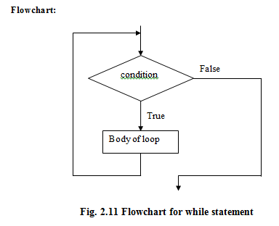

Slide 23
Example:
i=1
n=int(input(“enter number of items to be printed”))
while(i<=n):
print(i)
i=i+1
Output
enter number of items to be printed 4
1
2
3
4

Slide 24
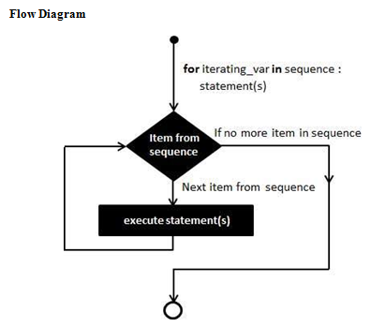
for LOOP
Syntax :
for item in sequence:
body of for

Slide 25
Example:
fruits = ['banana', 'apple', 'mango']
for fruit in fruits: # Second Example
print 'Current fruit :', fruit
Output
Current fruit : banana
Current fruit : apple
Current fruit : mango

Slide 26
List
A list is a sequence of values
The values in a list are called elements or
sometimes items. they can be any type
list contains a string, a float, an integer.
Syntax
elements in square brackets […]
[10, 20, 30, 40]
[a', ‘b', ‘c']

Slide 27
Accessing Values in Lists
To access values in lists, use the square brackets for slicing along with the index or indices to obtain value available at that index
Example
list1 = ['physics', 'chemistry', 1997, 2000]
list2 = [1, 2, 3, 4, 5, 6, 7 ]
print "list1[0]: ", list1[0]
print "list2[1:5]: ", list2[1:5]
OUTPUT
list1[0]: physics
list2[1:5]: [2, 3, 4, 5]

Slide 28
Updating Lists
Update single or multiple elements of lists by left-hand side of
the assignment operator or append method
Example
list = ['physics', 'chemistry', 1997, 2000]
print "Value available at index 2 : "
print list[2]
list[2] = 2001
print "New value available at index 2 : “
print list[2]
OUTPUT
Value available at index 2 : 1997
New value available at index 2 : 2001

Slide 29
Delete List Elements
To remove a list element, use del statement
Example
list1 = ['physics', 'chemistry', 1997, 2000]
print list1
del list1[2]
print "After deleting value at index 2 : “
print list1
OUTPUT
['physics', 'chemistry', 1997, 2000]
After deleting value at index 2 : ['physics', 'chemistry', 2000]

Slide 30
List operations
Lists respond to the + and * operators much like strings; they mean concatenation and repetition.
The + operator concatenates lists:
>>> a = [1, 2, 3]
>>> b = [4, 5, 6]
>>> c = a + b
>>> print c
[1, 2, 3, 4, 5, 6]
Similarly, the * operator repeats a list a given number of times:
>>> [0] * 4
[0, 0, 0, 0]
>>> [1, 2, 3] * 3
[1, 2, 3, 1, 2, 3, 1, 2, 3]
The first example repeats [0] four times. The second example repeats the list [1, 2, 3] three times.

Slide 31
List slices
The slice operator also works on lists:
>>> t = ['a', 'b', 'c', 'd', 'e', 'f']
>>> t[1:3]
['b', 'c']
>>> t[:4]
['a', 'b', 'c', 'd']
>>> t[3:]
['d', 'e', 'f']
If you omit the first index, the slice starts at the beginning. If you omit the second, the slicecgoes to the end. So if you omit both, the slice is a copy of the whole list.
>>> t[:]
['a', 'b', 'c', 'd', 'e', 'f']
Since lists are mutable, it is often useful to make a copy before performing operations that fold, spindle or mutilate lists.
A slice operator on the left side of an assignment can update multiple elements:
>>> t = ['a', 'b', 'c', 'd', 'e', 'f']
>>> t[1:3] = ['x', 'y']
>>> print t
['a', 'x', 'y', 'd', 'e', 'f']

Slide 32
List methods

Slide 33
Append():
adds a new element to the end of a list
>>> t = ['a', 'b', 'c']
>>> t.append('d')
>>> print t
['a', 'b', 'c', 'd']
Extend():
extend takes a list as an argument and appends all of the elements
>>> t1 = ['a', 'b', 'c']
>>> t2 = ['d', 'e']
>>> t1.extend(t2)
>>> print t1
['a', 'b', 'c', 'd', 'e']

Slide 34
Sort():
Arranges the elements of the list from low to high:
>>> t = ['d', 'c', 'e', 'b', 'a']
>>> t.sort()
>>> print t
['a', 'b', 'c', 'd', 'e']
Count():
method returns count of how many times obj occurs in list.
aList = [123, 'xyz', 'zara', 'abc', 123]
print "Count for 123 : ", aList.count(123)
print "Count for zara : ", aList.count('zara')
OUTPUT:
Count for 123 : 2
Count for zara : 1

Slide 35
Index():
returns index
aList = [123, 'xyz', 'zara', 'abc']
print "Index for xyz : ", aList.index( 'xyz' )
print "Index for zara : ", aList.index( 'zara' )
OUTPUT
Index for xyz : 1
Index for zara : 2
Insert(index,obj)
inserts the given element at the given index
aList = [123, 'xyz', 'zara', 'abc']
aList.insert( 3, 2009)
print "Final List : ", aList
Final List : [123, 'xyz', 'zara', 2009, 'abc']

Slide 36
Pop()
removes and returns last object
List = [123, 'xyz', 'zara', 'abc']
print "A List : ", aList.pop()
print "B List : ", aList.pop(2)
O/P
A List : abc
B List : zara
Remove()
removes the given object from the list.
aList = [123, 'xyz', 'zara', 'abc', 'xyz']
aList.remove('xyz')
print "List : ", aList
aList.remove('abc')
print "List : ", aList
O/P
List : [123, 'zara', 'abc', 'xyz']
List : [123, 'zara', 'xyz']

Slide 37
Reverse()
reverse the given object from the list.
aList = [123, 'xyz', 'zara', 'abc', 'xyz']
aList.reverse()
print "List : ", aList
O/P
List : ['xyz', 'abc', 'zara', 'xyz', 123]

Slide 38
Built-in functions in list

Slide 39
List loop
Example:
>>> mylist = [[1,2,3],[4,5,6,7],[8,9,10]]
>>> for x in mylist:
if len(x)==3:
print x
O/P
[1, 2, 3] [8, 9, 10]

Slide 40
List Mutability
Example:
lists are mutable.
bracket operator appears on the left side of an assignment, it identifies the element of the list that
>>> numbers = [17, 123]
>>> numbers[1] = 5
>>> print numbers
[17, 5]will be assigned

Slide 41
List indices work the same way as string indices:
Any integer expression can be used as an index.
If you try to read or write an element that does not exist, you get an IndexError.
If an index has a negative value, it counts backward from the end of the list.
The in operator also works on lists
>>> cheeses = ['Cheddar', 'Edam', 'Gouda']
>>> 'Edam' in cheeses
True
>>> 'Brie' in cheeses
Falsekward from the end of the list.

Slide 42
Cloning lists
Example:
original_list = [10, 22, 44, 23, 4]
new_list = list(original_list)
print(original_list)
print(new_list)
O/P:
[10, 22, 44, 23, 4]
[10, 22, 44, 23, 4]

Slide 43
List Parameters
When you pass a list to a function, the function gets a reference to the list. If the function modifies a list parameter, the caller sees the change. For example, delete_head removes the first element from a list:
def delete_head(t):
del t[0]
Here’s how it is used:
>>> letters = ['a', 'b', 'c']
>>> delete_head(letters)
>>> print letters
['b', 'c']

Slide 44
List Comprehension
Language feature to support built in function map and operator called list comprehension
[x**2 for x in range(0,5)]
[0,1,4,9,16,25]

Slide 45
Tuple Assignment
A tuple is a sequence of values.
The values can be any type, and they are indexed by integers
Tuples are immutable
Example Swap to variables
>>> temp = a
>>> a = b
>>> b = temp
Tuple assignment
>>> a, b = b, a

Slide 46
The left side is a tuple of variables; the right side is a tuple of expressions
Each value is assigned to its respective variable
>>> a, b = 1, 2, 3
ValueError: too many values to unpack
The number of variables on the left and the number of values on the right have to be the same

Slide 47
Tuples as return values
a function can only return one value
For example, if you want to divide two integers and compute the quotient and remainder
it is inefficient to compute x/y and then x%y.
It is better to compute them both at the same time

Slide 48
The built-in function divmod takes two arguments and returns a tuple of two values, the quotient and remainder
>>> t = divmod(7, 3)
>>> print t (2, 1)
To store the result as a tuple use
>>> quot, rem = divmod(7, 3)
>>> print quot 2
>>> print rem 1

Slide 49
example for a function that returns a tuple
def min_max(t):
return min(t), max(t)
max and min are built-in functions that find the largest and smallest elements of a sequence]
min_max computes both and returns a tuple of two values

Slide 50
Dictionaries
A dictionary is like a list
Dictionary is a mapping between a set of indices (which are called keys) and a set of values.
Each key maps to a value. The association of a key and a value is called a key-value pair or sometimes an item
In a list, the indices have to be integers; in a dictionary they can be (almost) any type
The function dict creates a new dictionary with no items
dict is the name of a built-in function, avoid using as a variable name
>>> eng2sp = dict()
>>> print eng2sp
{}-----→ empty dictionary

Slide 51
Ex1:
>>> eng2sp['one'] = 'uno‘
>>> print eng2sp
{'one': 'uno'}
The output format is also an input format
Ex2:
>>> eng2sp = {'one': 'uno', 'two': 'dos', 'three': 'tres'}
>>> print eng2sp
{'one': 'uno', 'three': 'tres', 'two': 'dos'}

Slide 52
Accessing Values in Dictionary
To access dictionary elements, use square bracket
dict = {'Name': ‘python', 'Age': 7, 'Class': 'First'}
print "dict['Name']: ", dict['Name']
print "dict['Age']: ", dict['Age‘]
Output dict['Name']: python dict['Age']: 7

Slide 53
Updating Dictionary
update a dictionary by adding a new entry or a key-value pair
dict = {'Name': 'Zara', 'Age': 7, 'Class': 'First'} dict['Age'] = 8; # update existing entry dict['School'] = "DPS School"; # Add new entry print "dict['Age']: ", dict['Age']
print "dict['School']: ", dict['School']
OUTPUT:
dict['Age']: 8
dict['School']: DPS School

Slide 54
Delete Dictionary Elements
removes individual dictionary elements or clears the entire contents of a dictionary
dict = {'Name': 'Zara', 'Age': 7, 'Class': 'First'}
del dict['Name']; # remove entry with key 'Name' dict.clear(); # remove all entries in dict
del dict ; # delete entire dictionary
print "dict['Age']: ", dict['Age']
print "dict['School']: ", dict['School']
OUTPUT
dict['Age']: Traceback (most recent call last): File "test.py", line 8, in <module>
print "dict['Age']: ", dict['Age'];
TypeError: 'type' object is unsubscriptable

Slide 55
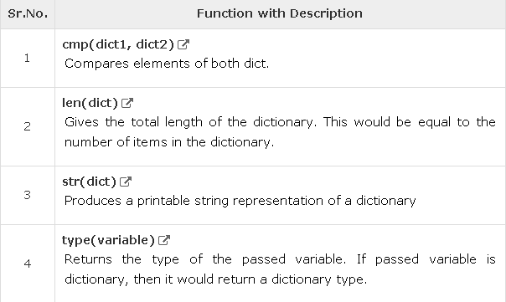
Built-in Dictionary Functions

Slide 56
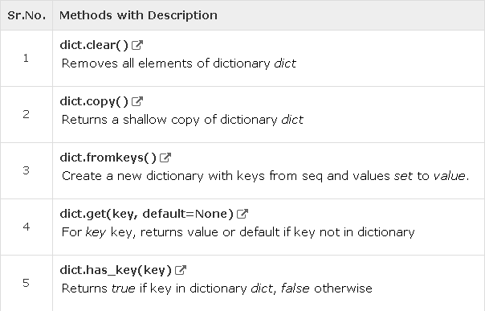
Dictionary Methods

Slide 57
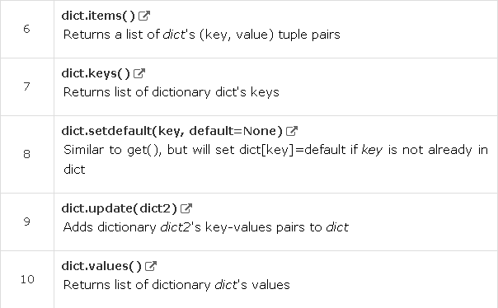

Slide 58
dict.clear()
dict = {'Name': 'Zara', 'Age': 7}; print "Start Len : %d" , len(dict) dict.clear()
print "End Len : %d" , len(dict)
o/p
Start Len : 2 End Len : 0
dict.copy()
dict1 = {'Name': 'Zara', 'Age': 7}; dict2 = dict1.copy()
print "New Dictionary : %s" (dict2)
O/p
Dictionary : {'Name': 'Zara‘, 'Age': 7}

Slide 59
fromkeys()
Parameters
seq − list of values which would be used for dictionary keys
preparation.
value − optional, if provided then value would be set to this
value
dict.fromkeys(seq[, value]) seq = ('name', 'age', 'sex') dict = dict.fromkeys(seq)
print “ Dictionary : %s" % str(dict) dict = dict.fromkeys(seq, 10)
print "New Dictionary : %s" % str(dict)
O/p
Dictionary : {'age': None, 'name': None, 'sex': None}
New Dictionary : {'age': 10, 'name': 10, 'sex': 10}

Slide 60
get()
returns a value for the given key.
If key is not available then returns default value None
dict = {'Name': 'Zabra', 'Age': 7} print "Value : %s" % dict.get('Age')
print "Value : %s" % dict.get('Education', "Never")
O/p
Value : 7 Value : Never

Slide 61
has_key()
returns true if a given key is available in the dictionary, otherwise it returns a false
dict = {'Name': 'Zara', 'Age': 7}
print "Value : %s" % dict.has_key('Age') print "Value : %s" % dict.has_key('Sex')
O/p
Value : True Value : False

Slide 62
items()
returns a list of tuple pairs dict = {'Name': 'Zara', 'Age': 7}
print "Value : %s" % dict.items()
O/p
Value : [('Age', 7), ('Name', 'Zara')]

Slide 63
dict.keys()
returns a list of all the available keys in the dictionary
dict = {'Name': 'Zara', 'Age': 7} print "Value : %s" % dict.keys()
O/p
Value : ['Age', 'Name']
setdefault()
dict = {'Name': 'Zara', 'Age': 7}
print "Value : %s" % dict.setdefault('Age', None) print "Value : %s" % dict.setdefault('Sex', None)
O/p
Value : 7 Value : None

Slide 64
update()
adds dictionary dict2's key-values pairs in to dict
dict = {'Name': 'Zara', 'Age': 7} dict2 = {'Sex': 'female' } dict.update(dict2)
print "Value : %s" % dict
O/p
Value : {'Age': 7, 'Name': 'Zara', 'Sex': 'female'}

Slide 65
values()
returns a list of all the values available in a given dictionary.
dict = {'Name': 'Zara', 'Age': 7} print "Value : %s" % dict.values()
O/p
Value : [7, 'Zara']

